Slide 1
AUST BUDDY
YOUR BEST BUDDY IN AUST

Slide 2
Group Members Group-06
Tabassum Tara Lamia- 20200104128
Parvez Ahammed - 20200104129
Sabbir Ahammed Salman 20200104146

Slide 3
AUST BUDDY
BY THE AUSTIANS
FOR THE AUSTIANS

Slide 4
Project Goals
Accessibility.
User Experience
Good relationships.
Providing ease access to info.
Cost-effectiveness.
Time saving
Organization
Collaboration
GPA Calculation
Increasing efficiency.

Slide 5
Project Features
Scan notes
Calculator
Public Announcement
Request for update
Settings
Create groups
Post schedules
Add members
Edit/Delete members
Members list
View updates
Add notes
Notes List
Get teachers information

Slide 6
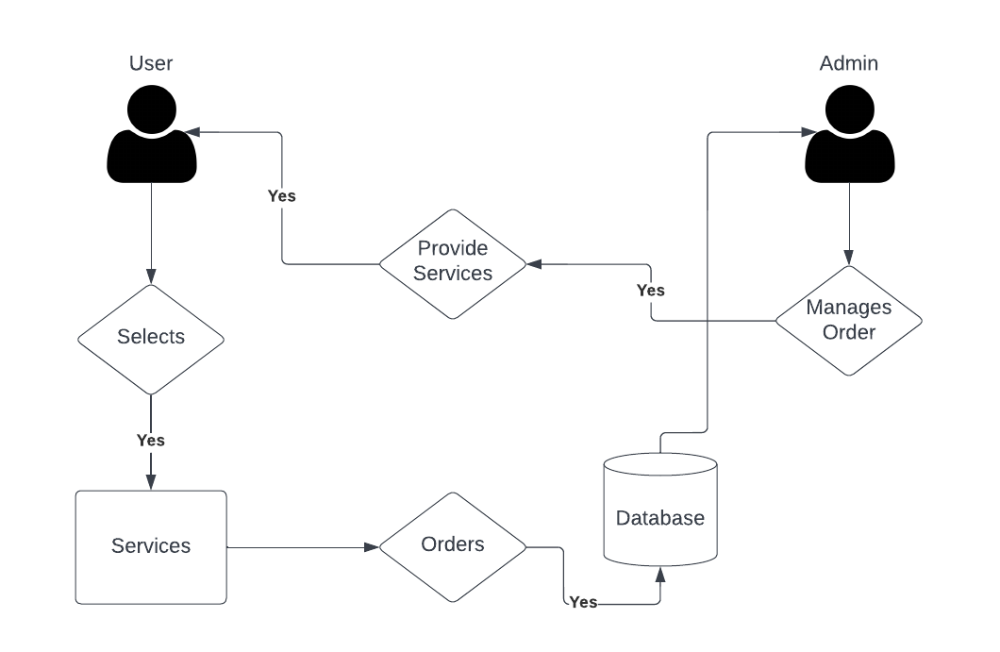
Architecture Flow Diagram

Slide 7
Feasibility
1
2
3
4
Operational
feasibility
Economic
feasibility
Technical
feasibility
Legal
feasibility

Slide 8
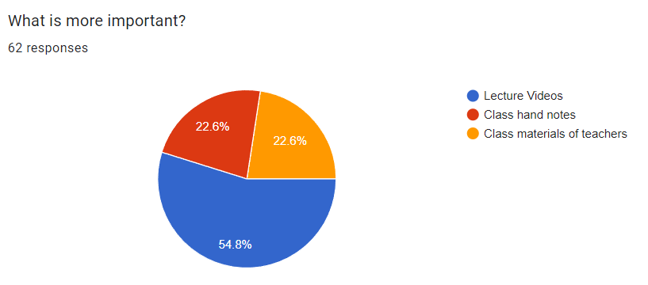
Data Collection (User)

Slide 9
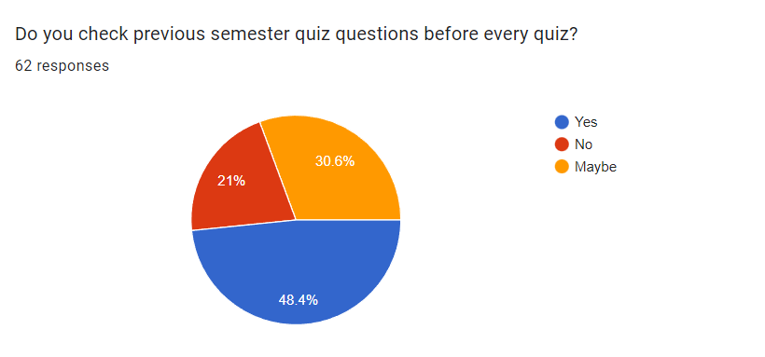
Data Collection (User)

Slide 10
Data Collection (User)

Slide 11
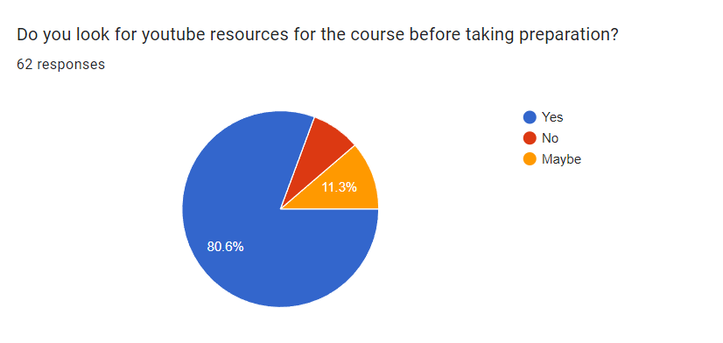
Data Collection (User)

Slide 12
Data Collection (User)

Slide 13
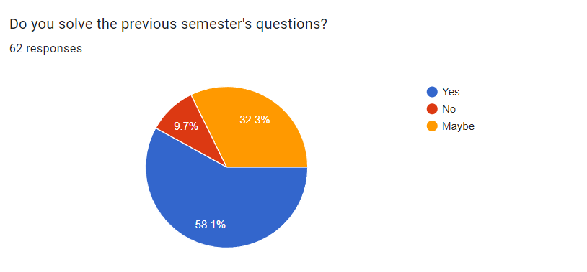
Data Collection (User)

Slide 14
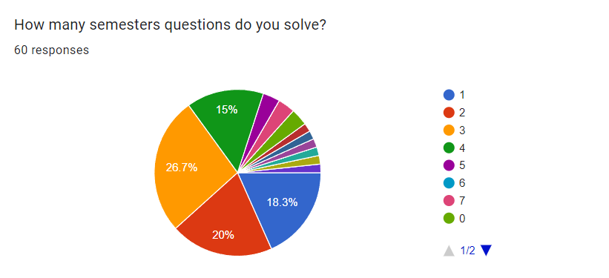
Data Collection (User)

Slide 15
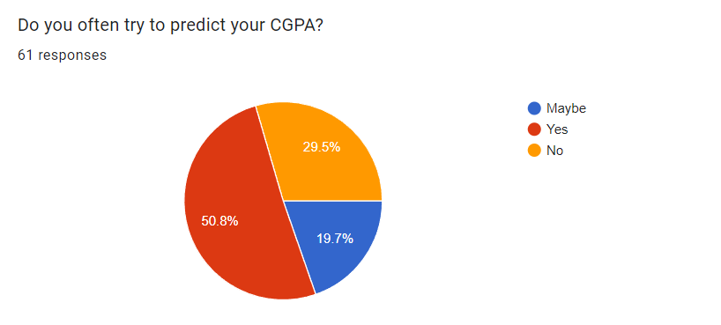
Data Collection (User)

Slide 16
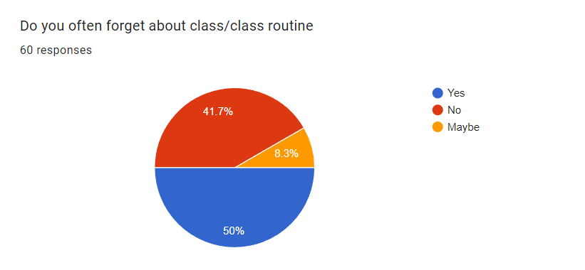
Data Collection (User)

Slide 17
Cost Benefit Analysis
Cost Benifit Analysis
Present Value, PV= 1,00,000 BDT
Time (in years), n = 5
Interest Rate, I = 20%
Future Value, FV = PV*(1+i) ^ n
=1,00,000*(1+0.20) ^ 5
= 248832 BDT (approx.)

Slide 18
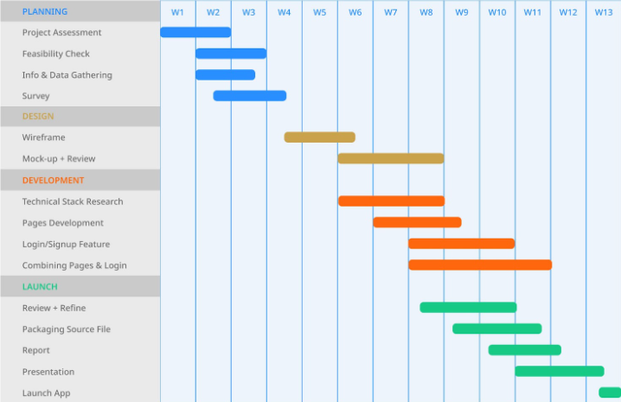
Project Scheduling

Slide 19
Risk Analysis
Contributions
Development
Security
Funding

Slide 20
Conclusion
In conclusion, the "AUST BUDDY" project is an Android Studio-based mobile educational application created with Kotlin and Firebase.
It seeks to give students a user-friendly setting where they may keep track of their semester notes, gets official university notifications, computes their grade point average, and facilitate communication with officials.

Slide 21

Any Queries?

